Slide 1

Phishing Website Detector Project Synopsis Presentation Date: 05/05/23
MCA (MCA465)
Degree : < MCA>
Project Guide:
Mr. Gaurav Kumar Rajput
Toshika Ahlawat(TCA2163099)
Utkarsh Gupta (TCA2163100)
FACULTY OF ENGINEERING & COMPUTING SCIENCES
TEERTHANKER MAHAVEER UNIVERSITY, MORADABAD

Slide 2

INTRODUCTION
• Phishing is the most commonly used social engineering and cyber attack.
• Through such attacks, the phisher targets naïve online users by tricking them into revealing confidential information, with the purpose of using it fraudulently.
• In order to avoid getting phished, users should have awareness of phishing websites have a blacklist of phishing websites which requires the knowledge of website being detected as phishing detect them in their early appearance, using machine learning and deep neural network algorithms.
• Of the above three, the machine learning based method is proven to be most effective than the other methods.
• Even then, online users are still being trapped into revealing sensitive information in phishing websites.
2
T002/version 1.3

Slide 3
OBJECTIVES
A phishing website is a common social engineering method that mimics trustful uniform resource locators (URLs) and webpages. The objective of this project is to train machine learning models and deep neural nets on the dataset created to predict phishing websites. Both phishing and benign URLs of websites are gathered to form a dataset and from them required URL and website content-based features are extracted. The performance level of each model is measures and compared./ Tools to be use
3
T002/version 1.3

Slide 4
APPROACH
Below mentioned are the steps involved in the completion of this project:
• Collect dataset containing phishing and legitimate websites from the open source platforms.
• Write a code to extract the required features from the URL database.
• Analyze and preprocess the dataset by using EDA techniques.
• Divide the dataset into training and testing sets.
• Run selected machine learning and deep neural network algorithms like decision tree, Random Forest, Autoencoder on the dataset.
• Write a code for displaying the evaluation result considering accuracy metrics.
• Compare the obtained results for trained models and specify which is better.
4
T002/version 1.3

Slide 5
FEATURE SELECTION
The following category of features are selected:
Address Bar based Features
Domain based Features
HTML & Javascript based Feature
Address Bar based Features considered are:
Domian of URL
Redirection ‘//’ in URL
IP Address in URL
‘http/https’ in Domain name
‘@’ Symbol in URL
Using URL Shortening Service
Length of URL
Prefix or Suffix "-" in Domain
Depth of URL
5 T002/version 1.3

Slide 6
FEATURE SELECTION (CONT.)
Domain based Features considered are:
• DNS Record
• Age of Domain
• Website Traffic
• End Period of Domain
HTML and JavaScript based Features considered are:
• Iframe Redirection
• Disabling Right Click
• Status Bar Customization
• Website Forwarding
All together 17 features are extracted from the dataset.
6
T002/version 1.3

Slide 7
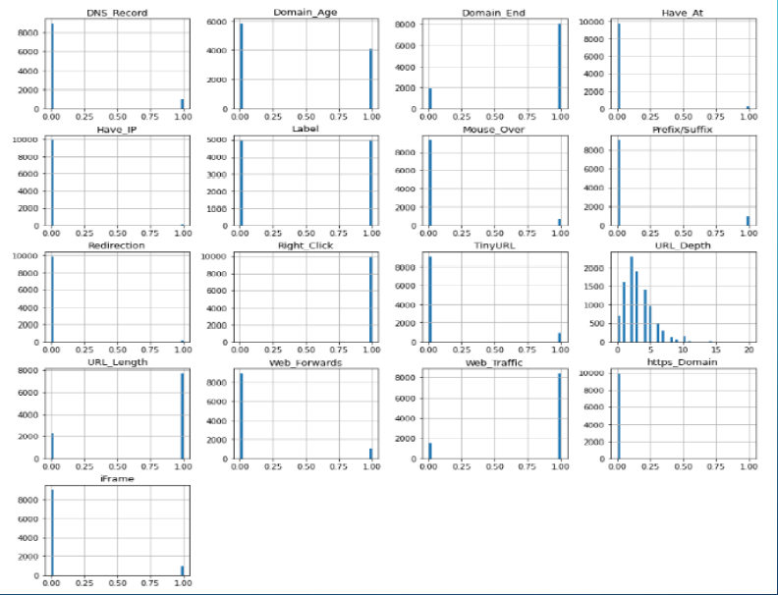
FEATURES DISTRIBUTION
7
T002/version 1.3

Slide 8
MACHINE LEARNING MODELS
This is a supervised machine learning task. There are two major types of supervised machine learning problems, called classification and regression.
• This data set comes under classification problem, as the input URL is classified as phishing (1) or legitimate (0).
The machine learning models (classification) considered to train the dataset in this notebook are:
• Decision Tree
• Random Forest
• Multilayer Perceptrons
• XGBoost
• Autoencoder Neural Network
• Support Vector Machines
8
T002/version 1.3

Slide 9
\
Advantage of The Project
There are several advantages to implementing this project, including:
Increased Security: One of the primary advantages of using a phishing website detector is increased security.
Easy to Use: Another advantage of this project is its ease of use.
Cost-Effective: Implementing a phishing website detector using PHP is a cost-effective solution for detecting phishing sites.
Customizable: PHP is a highly customizable programming language, which means that the phishing website detector can be tailored to suit the specific needs of the user..
Scalable: The project phishing website detector using PHP is also scalable, which means that it can be easily adapted to handle larger volumes of data and traffic as the user base grows.
9
T002/version 1.3

Slide 10
\
DATA FLOW DIAGRAM-1
AUTHORIZED URL DATABASE
IIIINPUT URLS
DIVIDE INTO SUB-STRINGS
SIMILAR STRING MATCHING
PHISHING REPORT
10
T002/version 1.3

Slide 11
\
DATA FLOW DIAGRAM-2
AUTHORIZED IP'S DATABASE
INPUT URLS
CONVERT INTO IP
IP COMPARISON
PHISHING REPORT
11
T002/version 1.3

Slide 12
-
CONCLUSION
In conclusion, the project "Phishing Website Detector using PHP" has been successfully implemented and achieved its goals. The project aimed to develop a web-based application that could identify phishing websites and provide users with warnings to avoid visiting them.
The project used several technologies such as PHP, HTML, CSS, and JavaScript, which allowed us to create a user-friendly interface that is easy to navigate. The application was designed to detect phishing websites by analyzing various attributes of the website such as URL, SSL certificate, page content, etc. The project also implemented an email notification system that alerts users when they encounter a potentially harmful website.
One of the strengths of this project is its ability to continuously update its database of known phishing websites, which ensures that users are provided with the most up-to-date information. Additionally, the project's user-friendly interface and clear warning messages make it accessible to a wide range of users, regardless of their technical expertise.
Overall, the "Phishing Website Detector using PHP" project provides a valuable tool for users to protect themselves from phishing attacks. By detecting and warning users about potentially harmful websites, this project can help prevent the theft of personal and sensitive information. Future enhancements to the project could include the integration of machine learning techniques to improve detection accuracy and reduce false positives.
12
T002/version 1.3

Slide 13
THANK YOU

